Slide 1



AN AGRICULTURAL E-COMMERCE APP
A Design Project Presented By:
NDIWANE TIMOTHY FUHNYUI (CT23A109)
And
BENNETT NDONGTSOP TSAMO (CT24A530)
Supervised By:
Dr. MELINGUI MELONO
24 JANUARY 2026

Slide 2

CONTENT
01
09
Introduction
Software Architecture
02
Literature Review
10
Methodology used
03
Motivation for topic
11
System design(use case diagram
04
Project Aim and Objective
System design(Class diagram)
12
05
System design(ER diagram)
Timeline
13
06
Requirement analysis
14
System design(UI)
07
15
SWOT Analysis
Conclusion
08
Software Architecture
(Tools)

Slide 3

Agriculture plays a vital role in Cameroon’s economy, employing a large percentage of the population and serving as a major source of food and income. Despite this importance, many small-scale farmers still face difficulties accessing reliable markets for their produce.
Agrinexa is a mobile-based agricultural marketplace designed to connect farmers directly with buyers, reduce the role of middlemen, and improve efficiency in agricultural trade through digital technology.
INTRODUCTION
01

Slide 4
LITERATURE
REVIEW
CropLink: CropLink is a mobile application produce by CropLink organization in the year 2021. It is use by Smallholder farmers in Cameroon to get the different types of fertilizers which they can use for a particular crop.
Strength: It helps farmers improve their rate of productivity.
Weaknesses: farmers can not sell their product through this application to buyer.
eFama: An agricultural mobile app that connect buyers directly to farmers, Restaurants. It was founded by Shadrack Kubyane (CEO) and Pretty Kubyane in the year 2022
Strength: It give farmer the ability to sell their product easily.
Weakness: it is general used only by south African, and no other country has the ability to register to the App.
Other alternatives solution include:
AgriApp: (Basavaraj Rudrappa, 2016)
Agri Tech:(Adamou Nchange, 2018)
Cassava marketplace:(launch by Cameroon Government, 10 June 2025
02

Slide 5


MOTIVATION FOR PROJECT
Inefficient Agricultural Marketing Systems
Excessive and Risky Travel for Agricultural Trade
Unfair Pricing in Agricultural Markets
Despite high agricultural production in many rural and high-productivity communities, farmers face serious challenges in effectively marketing and selling their produce due to poor market access, limited buyer reach, and inefficient distribution systems.
Business people and buyers are often required to travel frequently over long distances to purchase agricultural products, exposing them to safety risks, high transportation costs, and time loss due to the absence of a reliable digital marketplace.
Agricultural products are often sold to consumers at high and inconsistent prices due to the dominance of middlemen and inefficient market structures, despite farmers receiving low payments for their produce.
03

Slide 6
PROJECT AIM and OBJECTIVE
The aim of this is to build a mobile application (Agrinexa) that provides a structured digital marketplace for agricultural products, allows farmers to list their produce, buyers to place orders, and both parties to communicate directly there by solving the issue of unfair market price, risky traveling for agricultural product and many more. The system also supports delivery options, payment confirmation, and seller verification to ensure trust and transparency.
04

Slide 7

TIMELINE
Phases
Planning
Design
Development
Testing
Deployment
Activities
SOON
Requirement analysis & research
Application coding
Functional & user testing
Hosting & documentation
UI/UX & UML diagrams
Duration
05
1 week
2 week
7 week
1 week
1 week

Slide 8
REQUIREMENT ANALYSIS
(STATISTIC)
Functional Requirements
Non Functional Requirements
What the system should do:
Allow users to register and log in securely
Enable sellers to add, edit, and delete products
Allow buyers to browse and search products
Provide chat functionality between buyers and sellers
Allow buyers to choose delivery or self-pickup
Confirm payments and orders
How the system should behave:
Be user-friendly and easy to navigate
Provide fast response time
Ensure data security and privacy
Be scalable for future
Work reliably on No or moderate internet connections
Be compatible with Android devices
06

Slide 9
SWOT ANALYSIS
Strengths
Weaknesses
Direct farmer-to-buyer interaction
Reduced middlemen
Reduce crops price for consumers.
Internet dependency
Limited digital literacy among some farmers
Opportunities
Threats
Growing smartphone usage in Cameroon
Expansion to logistics and export markets
Network instability
Competition with similar apps or systems.
07

Slide 10
SOFTWARE ARCHITECTURE
(Tools)
UI/UX Design
UML Diagrams
Frontend
Backend
Database
Figma
StarUML
Flutter
PHP
Firebase
08

Slide 11


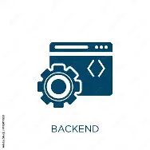



SOFTWARE ARCHITECTURE
User interface
Presentation tier
Client
Request
Response
Backend
Application tier
Server
Database
Data tier
09

Slide 12
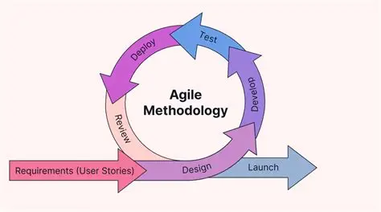

SOFTWARE ARCHITECTURE
(Methodology used)
Why Agile Methodology?
Incremental development
Continuous testing and feedback
Flexibility in handling changes
Faster delivery of the system feature
10

Slide 13
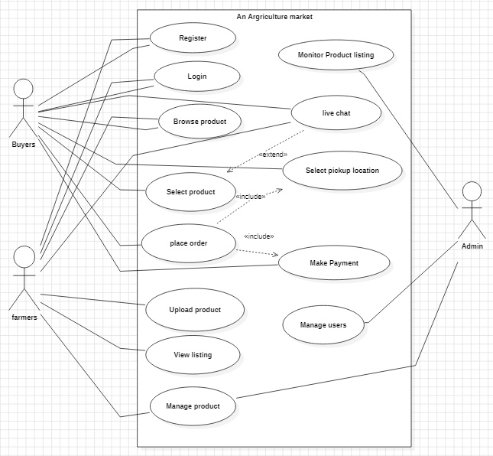
SYSTEM DESIGN
(Use Case Diagram)
SYSTEM DESIGN(Use Case Diagram)
Rufus Stewart
11

Slide 14
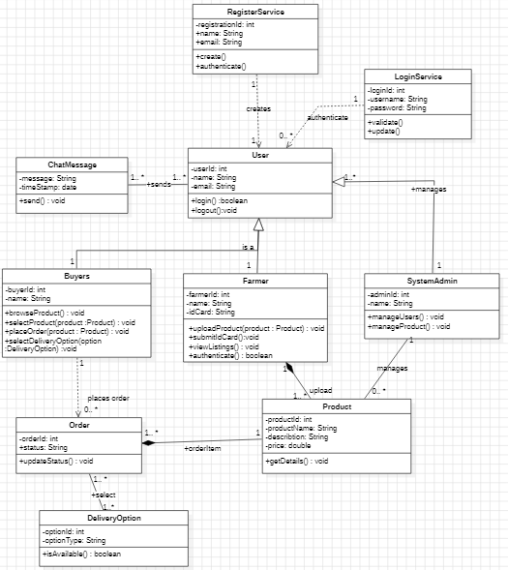
SYSTEM DESIGN
(Class diagram)
12

Slide 15
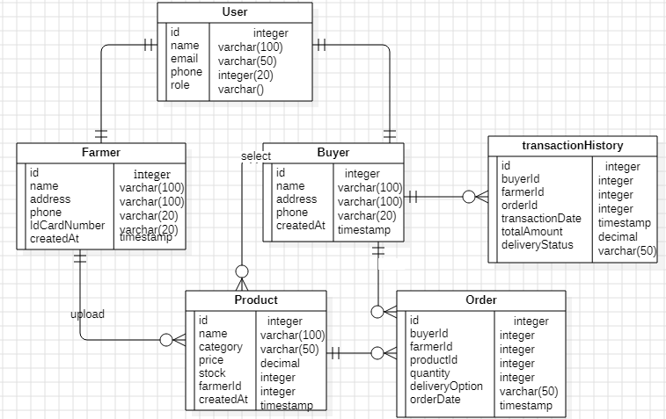
SYSTEM DESIGN
(ER Diagram)
13

Slide 16
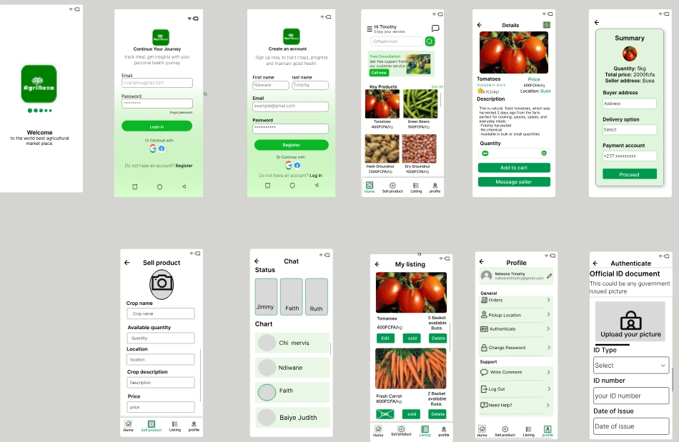
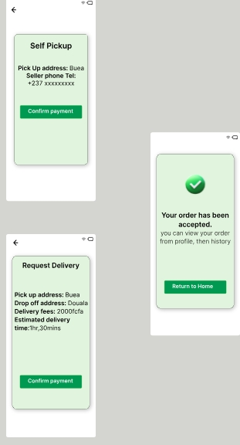
SYSTEM DESIGN( UI DESIGN WITH FIGMA)
14

Slide 17
CONCLUSION
The agricultural marketplace system should provides a secure and reliable platform that connects buyers and farmers digitally.
User authentication ensures that only registered and verified users can post products or place orders, improving system security and trust.
The system reduces unnecessary physical travel, thereby minimizing risks to life, saving time, and lowering transaction costs.
Direct communication between buyers and farmers helps eliminate middlemen and promotes fair pricing of agricultural products.
15

Slide 18
THANK YOU
FOR YOUR ATTENTION
January 2025

